Slide 1
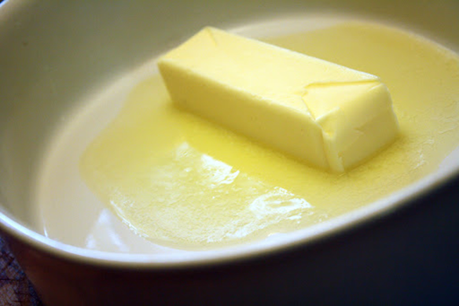
Butter Melt
Luis Porras Sam Morris
Faith Grimmeisen

Slide 2
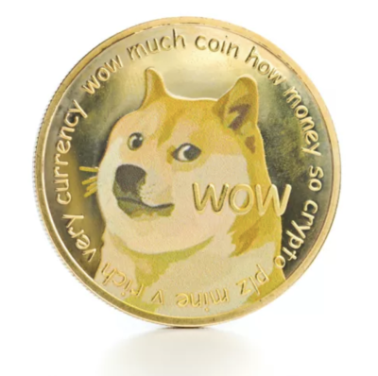
Butter Melt Topics
-The Goal
-Why Mobile?
-The Scenario
-Genre
-Target Audience
Notes:
Butter Melt is an arcade food game about saving a birthday party on the moon! In order to do this you must keep the butter the perfect temperature
So why should this be mobile. It has a simple game play loop with short levels making it perfect to kill a few minutes while waiting in line.
The perfect genre we feel for this would be an arcade style game where you get “Doge Coin” for surviving longer in the level plus some bonus coins when you win the level that you can spend on system upgrades
Typically most phone users are young teenagers so we plan to target this demographic by including a healthy amount of fresh memes.
NEXT SLIDE?? For Key Feature and Mechanics?
Some of the key features would be a shop system where you can spend your dodge coin during the level to try and keep the butter at the perfect temperature. Some of the items can include turn on the AC/Heater. A snow storm. Summon the solar flare. Block the sun among other things.

Slide 3
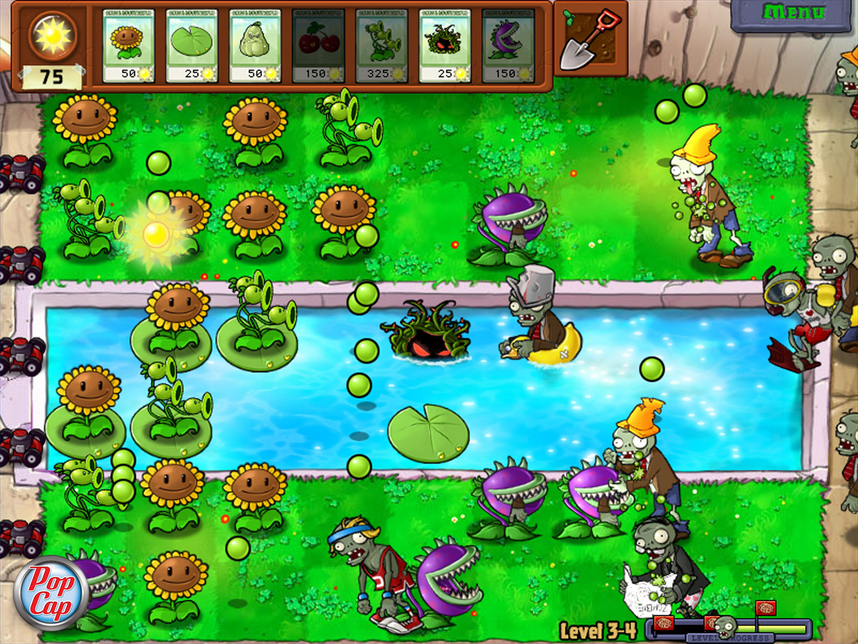
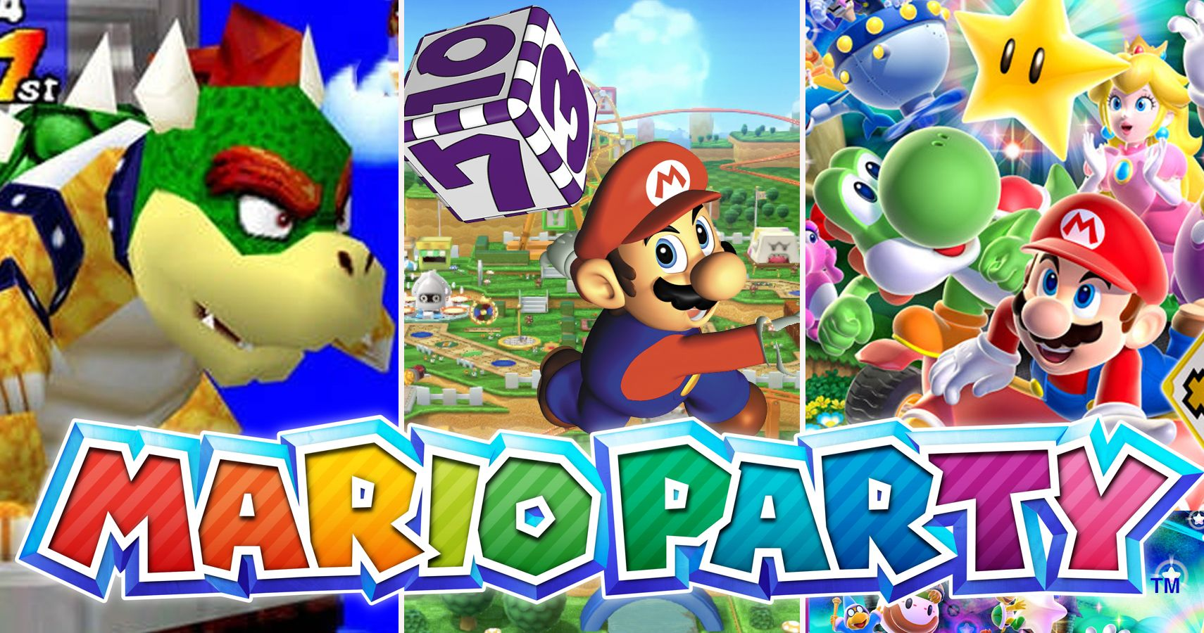
References
Notes:
Plants v Zombies inspired our progression system and difficulty curve. One example of our progression inspired by Plants vs. Zombies. Their shop involves gaining suns and spending them on defenses against the incoming zombies. We are implementing a similar system by having the player collect Doge coin to get items to help the player get to the Moon and save the day!
Mario Party also inspired the idea of butter melt through its mini-games. In Mario Party, there are thousands of mini-games that can be played by a user(s) as to determine if they won or not. Butter Melt is supposed to be similar to one of those mini-games but is intended to be played on mobile devices only.

Slide 4
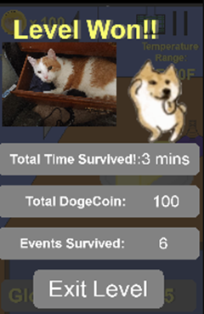
Concept Art
Notes:
-Mention this is what the GUI will look like. (pictures 1-4)
-The Lab will be the first level. The butter will be sitting on the lab while a tutorial plays. This level will be very easy to get players used to the mechanics.
The last picture, “The rocket” will be the main level. There will be a background moving up in the window to show the level.
NEXT SLIDE

Slide 5




Leaving Earth
Orbiting Earth
Deep Space
Elon’s Vacation
Notes:
Here are the backgrounds
The first level “Leaving Earth” has a view of earth as the rocket is leaving. Keeping the butter the perfect temperature should be easy here given the play is still in earth's atmosphere
When the play starts the earth orbit things should get interesting. The play will be fighting keep the butter from freezing as the rocket is behind earth and thus the outside temperature is very cold risking freezing the butter and ruining it.
Then after that the play reaches deep space and in line of sight of the sun causing the rocket to heat up rapidly. The play will now struggle to keep the butter from melting.
Finally the play reaches the moon. There will be a tight temperature range since the butter is so close to being used, THere will also be a large temperature fluctuation in order to add more of a challenge. (starts out very hot outside then cools off rapidly as the play reaches the moon. If the play is doing to well add in a random even to spice things up)

Slide 6
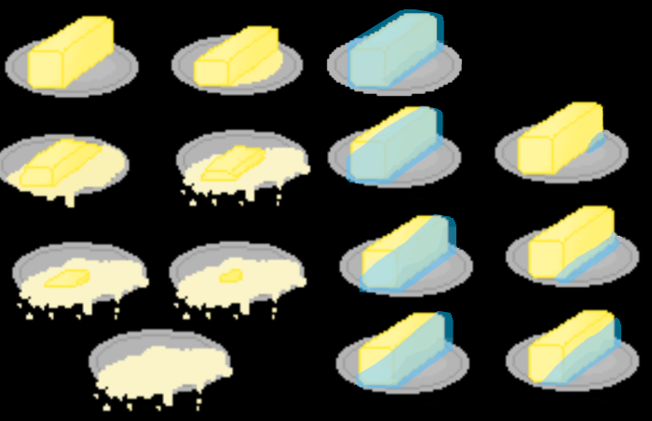
Butter Stage Sprites
Notes:
The butter sprite you saw before was a placeholder. These will be the actually sprites. Here you can see each stage of the butter. The player’s target will be to keep the butter in stage 1.
The art work you see is still a WIP

Slide 7
Game Mechanics
Mini-Game
Perfect Temperature
Outside Events
Items That Aid the Player
Item Uses
Interface
Notes:
The goal of the game is to keep the butter in the perfect range until the time runs out.
The whole goal of the game is to keep the butter in the perfect range. This range means that the butter is safe from getting too hot or too cold. While the player is in this perfect range, they get awarded DogeCoin
In this range, there is also a perfect temperature. If the player stays on this perfect temperature, they get awarded double the amount of DogeCoin.
These DogeCoin are used to purchase Items. These Items are used to aid the player to stay in the perfect range or the increase the rate you gain them.
Some of these Items include, fan, wind, ice storm, snow, lower temperature, heat wave, hot breeze, heater, oven, ice Bath, Double Points, or fire. To increase Praise Elon, Buy GME
If the Player got out of the perfect range, they have 5 seconds to get back into it. If they fail to do so, they lose a life. They have five lives in total and if they lose all of them the game is over.
This game will involve touch gesturing. The player will be able to touch the screen to help keep the butter warm/cool. They will also touch to purchase and place items to help aid the player to get the perfect temperature.

Slide 8
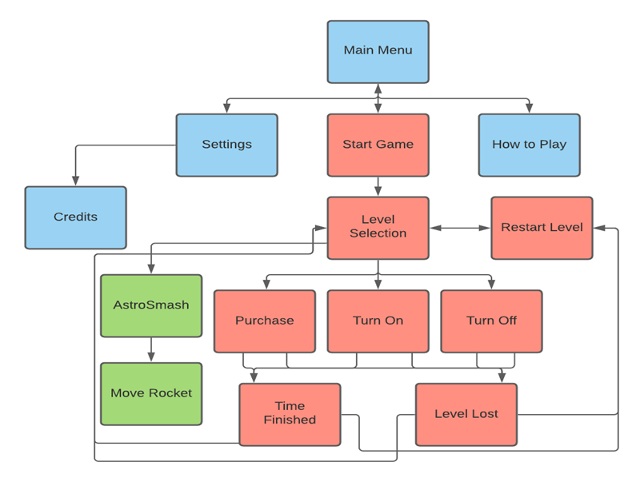
Game Flow
Notes:
This is the flow of how the game will run. We will start at the start Screen.
At the start screen will have four different places they could go to either Settings, Start the Game, Learn How to Play, or view the Credits.
If the player chooses Start Game then they go to level selection. In this level Selection they can choose the level.
During the game the player can purchase, place, and delete items to finish the level.
At the end, the game is either won or lost, and the player can choose if they want to go to the next level or restart the level.

Slide 9
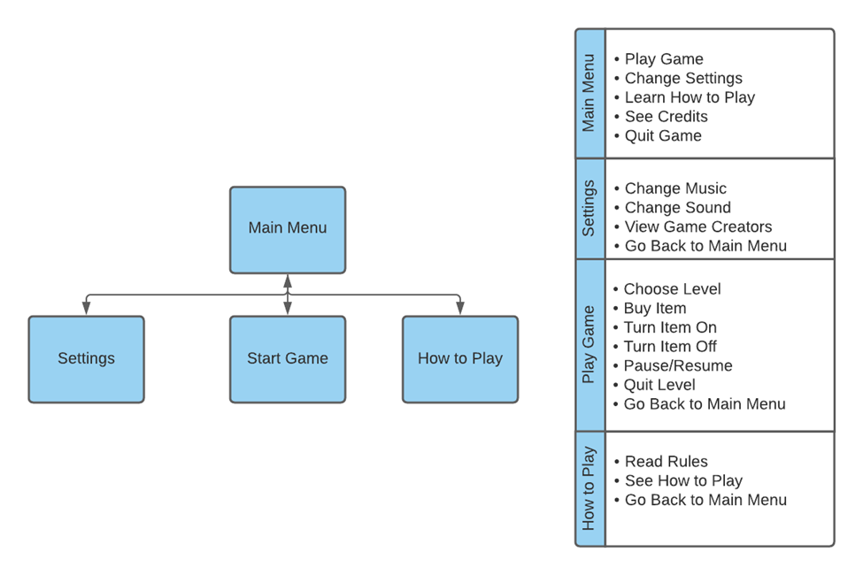
Screenflow
Notes:
The screenflow chart details all of our screens. It starts at the Main Menu.
In the Settings screen, the player can change the music, change the sound, or go back to the main menu.
In the How to Play screen, the player can read the rules, see how to play Butter Melt, or go back to the main menu.
In the Credits screen, the player can see the Creators and the tools used to create the game or go back to the main menu.

Slide 10




Resources
Art
Gimp
Music and Audio
bfxr
Internet
Organization and Code repository system
Github
Notes:
- The game will use Gimp to make the visual art and bfxr for audio. Solar 2D, formally known as the Corona Game engine, with lua for the app development.
-In order to coordinate development between team members Git Hub will be used.
.-The game will be designed in an isometric 2D style.

Slide 11
Discussion
We could not implement some things due to the time frame. For instance, we had originally planned to include more than 4 items however we ended up deciding to only add two items, heater and cooler, to the shop. We also proposed add a tapping even so the player could find a way to gain coin in the level scenes. In the end, we did not do this but instead added a physics mini-game to collect coins. The team initially wanted to make a scene that would congratulate the player but we could not do it in time. So, we just removed it all together and make a finite amount of levels. The proposal flow chart was a bit different from the end product. We ended up just creating the main menu and having the settings contain the credits button. The team had some difficulty collaborating. The main issue was that each team member was writing code that would interfere with another persons code. We decided that Faith would mainly work on the Gui design, Sam would work on some of the mechanics of the project and Luis would work on some of the object oriented files. We currently do not have plans on continuing this game however we hope that this game concept will help up in our careers.

